Slide 1



Performance Testing Dashboard

Slide 2




Project team
Dang Thi Thao My
Bui Nguyen Thien Khanh
Nguyen Anh Quan
Le Huynh Anh Tuan
15905067
15907679
15905072
1325907
Supervised by MSc. Truong Phuoc Loc

Slide 3
Agenda
What are our goals?
How do we do this?
What is the solution?
How do we ensure the quality?
What have we achieved?
What are challenges?
Demo

Slide 4
What are our goals?

Slide 5




Project Overview
Performance Testing Service
Validation Team

Slide 6
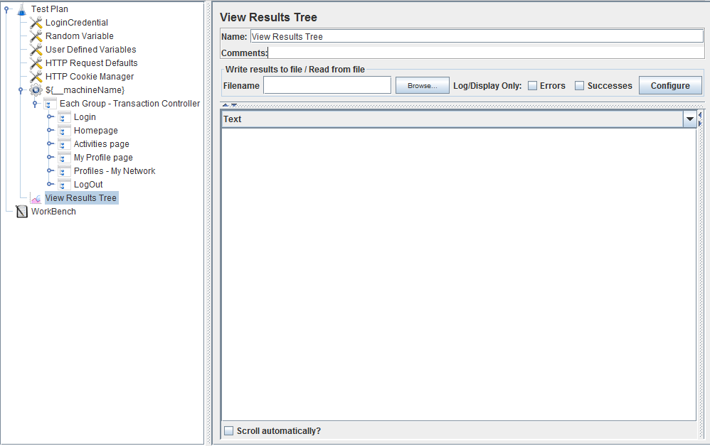



Report A
Report B
Report C
DOC

Slide 7

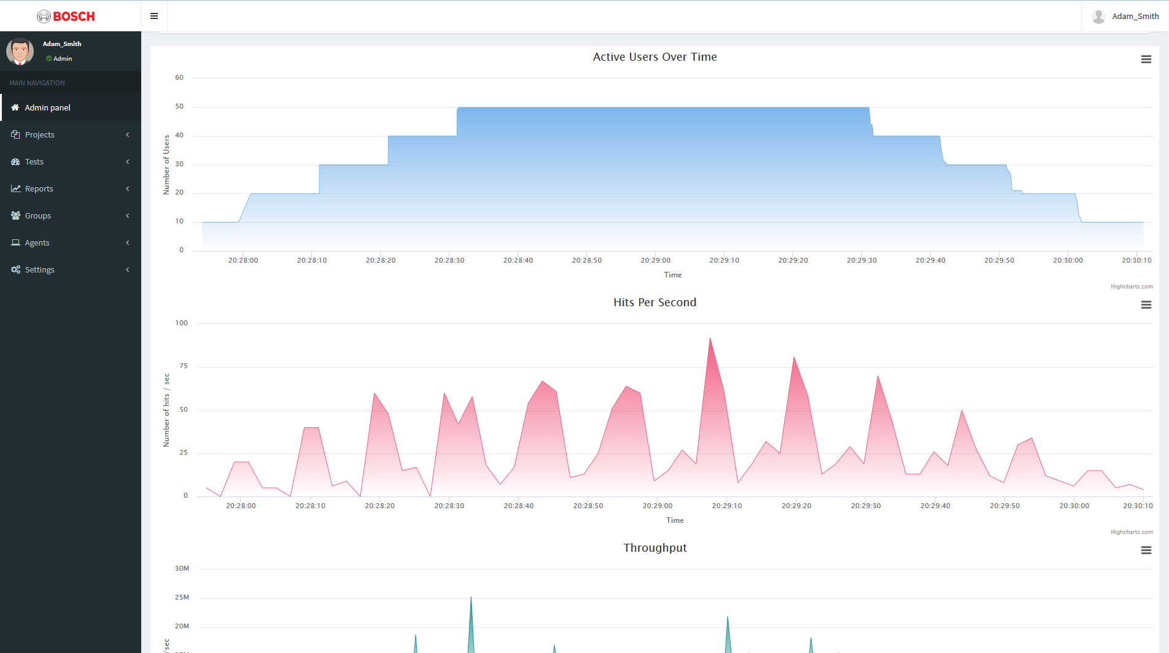
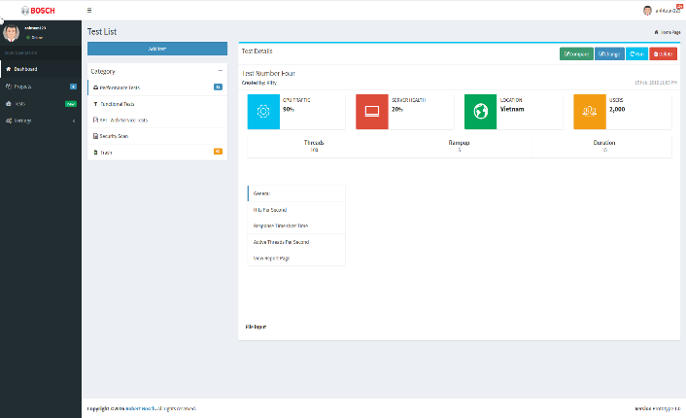
Projects
XML
DOC
Reports
Scripts
JMX
JTL
CSV
Performance Testing Dashboard

Slide 8

Project Description
Run Performance Test
Manage Test Scripts
Analyze test script and execute Jmeter
Upload , store , and manage the the test scripts
Manage Users
Provide Real-time Report
Authenticate Users to access pages
Authorize Users
Analyse test results immediately while test is executing and show in the dashboard
Control Distributed System
Manage Reports & Analysis
Connect Agents to the platform
Control Agents to run test
Analyse test results
Generate report after test execution
Track history of the reports

Slide 9
How do we do this?

Slide 10
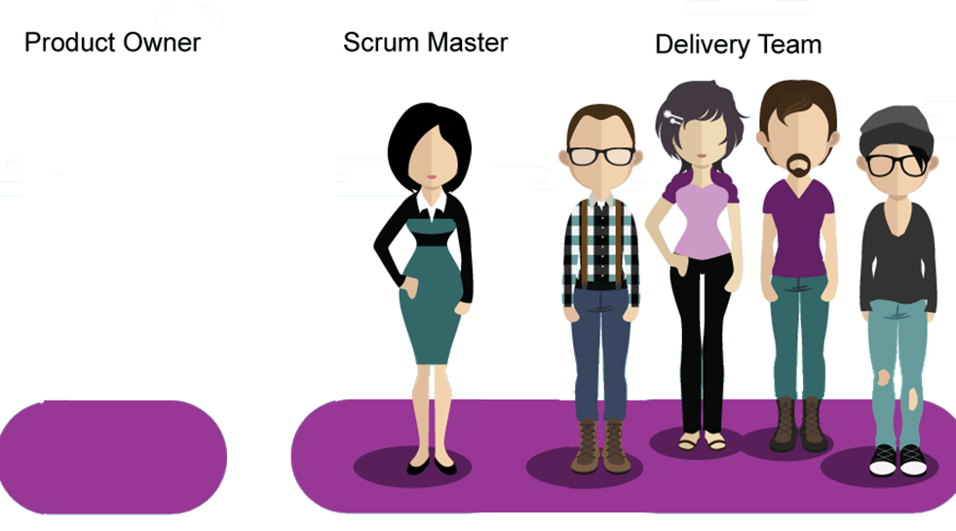

Roles
Mr. Man (Bosch)
My
Tuan
Khanh
Quan
Product Owner
Scrum Master
Development Team

Slide 11


Scrum
Sprint 4-14
Sprint 1-3
Analyze
Design
Implement
Review
Plan
Sprint 15-16
Knowledge Acquisition
Solution Design
Testing
Go Live

Slide 12
Milestones
Final Product
Go Live
Minimum Viable Product
Expansion
Release 2
Release 1
Emerging-Growth
May
December
January
March
Notes:
Release details 1 2 3

Slide 13
What is the solution?

Slide 14

















Solution Architecture
Agent
Dashboard Server
Dashboard
Agent
Upload Jmeter script
Agent
Distributed System
Target Service

Slide 15















Layered structure
Controller
REST Controller
Presentation
Templates
Views
Resources
Business
Engine
Service interfaces
Project
User
Test Case
Agent
Boot
Security
Configuration
Report Analysis
Data
Web MVC
Models
Persistence
Repositories
Entities

Slide 16

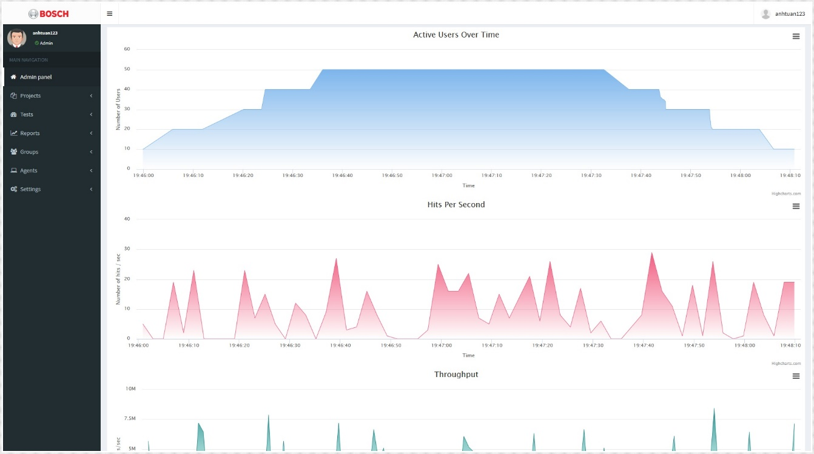


Benefits
Reduce Cost
Increase Effciency
Performance testing dashboard
Centralize Testing Management

Slide 17
How do we ensure the quality?

Slide 18
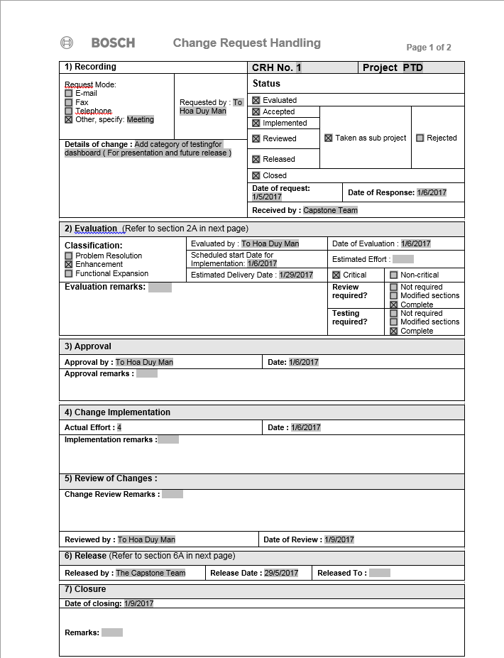


Quality Assurance and Quality Control
Register change when there are changes in requirement , technology or design
Peer review of codes for enhancements
Re-testing
Checklist for documentation
Planning
Daily
Review
Retrospective
Re-testing
Checklist
Register Change
Review

Slide 19


Quality Assurance and Quality Control
Requirements Development
Post Delivery
Bug-fix
Reviews
Verification
Validation
Requirements Management
Testing
Design
Integration
Coding
Test Plan
Test Cases
Issues Log
Testing Model
Peer Review
Notes:
During planning we proposed our approach on testing using Testing Model and Peer Review
Applicable with Scrum methodology
Testing began on Sprint 6 and continued until Sprint 15
6 testing releases have been executed

Slide 20
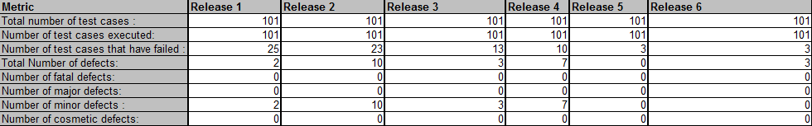
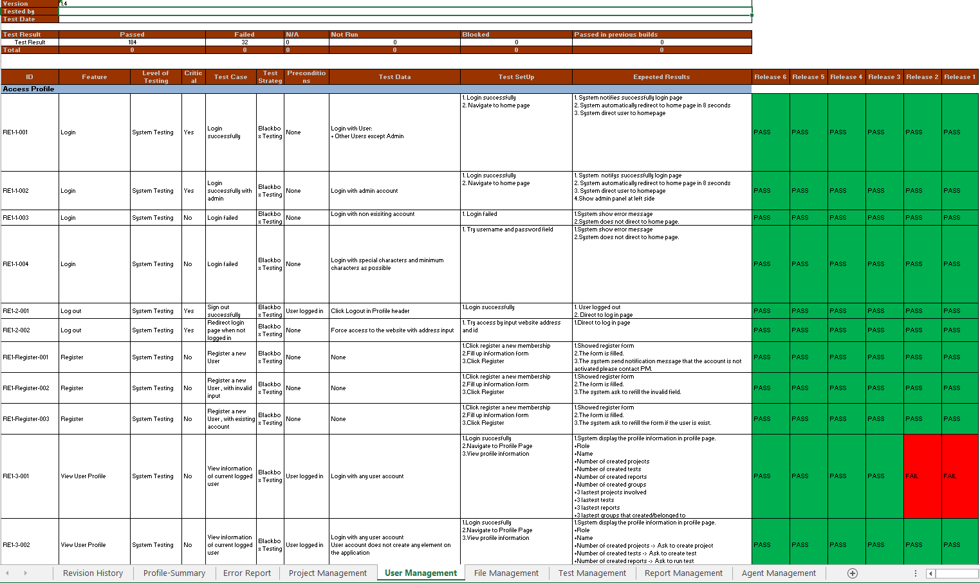
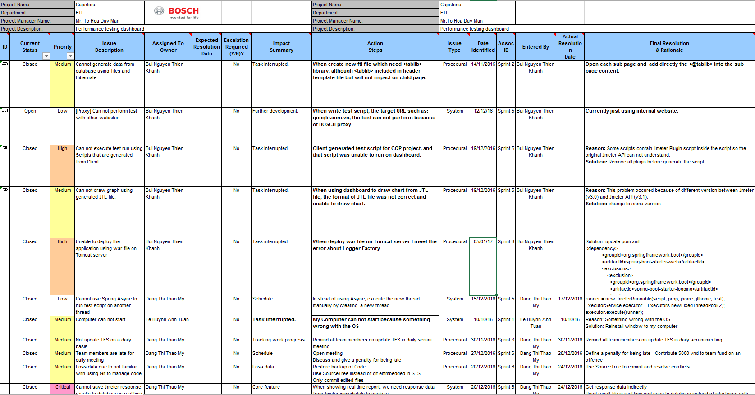
Quality Assurance and Quality Control
Test Cases and Issues Log updated – Test Report updated
Test Report
Test Cases
Issue Logs

Slide 21
What are challenges?

Slide 22









Challenges
Missing information
Trainings
Human Resources
Notes:
On boarding trainings
Meetings in office
Communication is not clear and lead to missing information ->
Human resource sometime is missing due to personal or study reasons -> Delay
Management and Personal Growth
Adapt the company culture and visions , learn basic knowledge about IT System at the company
Face to Face Conversation, Take Notes and Update Frequently
Distributed Tasks properly , get Delayed
Need to have several project to get the process -> Compare burn down chart

Slide 23
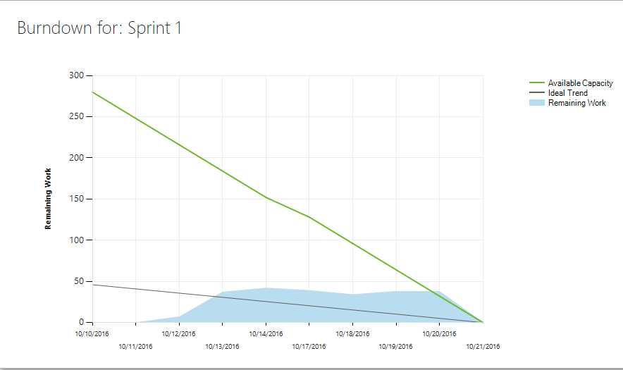
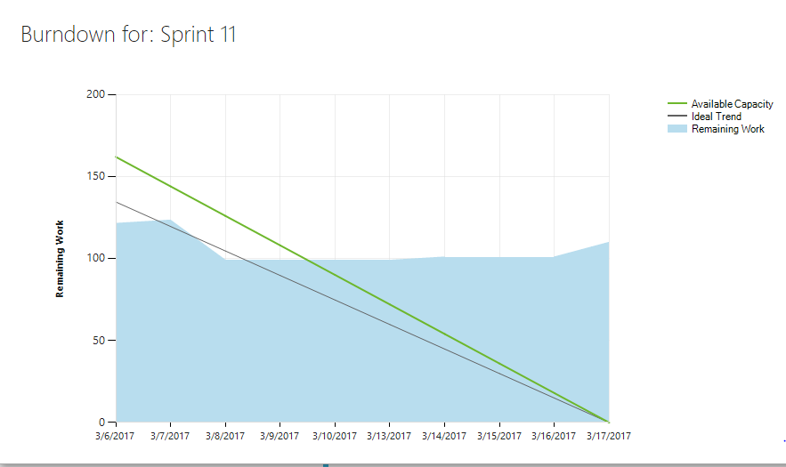
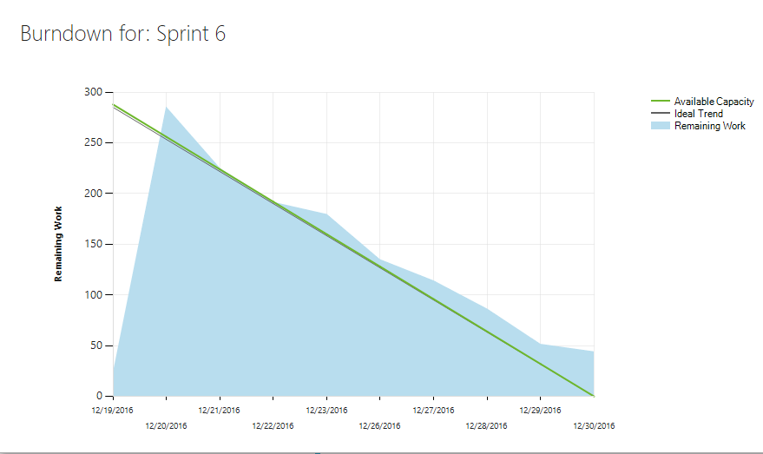
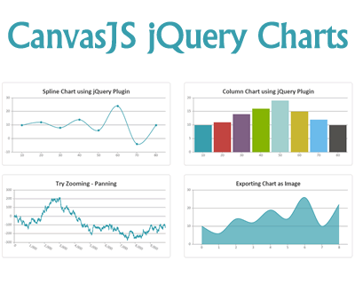










Challenges
Underestimated/Overestimated Estimation
Change Graph Technology
Need time for Research the Solutions
Notes:
Technical
Real-time data/ Report Analysis
Graph change from CanvasJS to Highcharts
Underestimated in Backlog Estimations -> Burndown chart
Distributed Testing
Need time for Research and Solutions
Solution
Dig dive into Source Code to Find Solutions
Time
Discussions
Problem Solving Skills

Slide 24
What have we achieved?

Slide 25




Achievements
Objectives
Knowledge
and Experience
Technologies
Skills
Notes:
Achieves all objectives on time
Learning experience
Interpersonal and professional skills improvement
Technology acquisition

Slide 26
It’s time for Demo

Slide 27
THANK YOU FOR WATCHING!

Slide 28
Q&A

